Slide 1

IPL Analysis RCB – IPL Strategy Abhinav Prem Topic – SQL Project

Slide 2
Problem Statement
As a sports data analyst hired by Royal Challengers Bangalore (RCB), my objective is to identify top-performing and reliable players who can drive the team to tournament victories. This analysis focuses on evaluating both on-field performance and value for money to optimize player selections during the 2017 mega player auction.

Slide 3
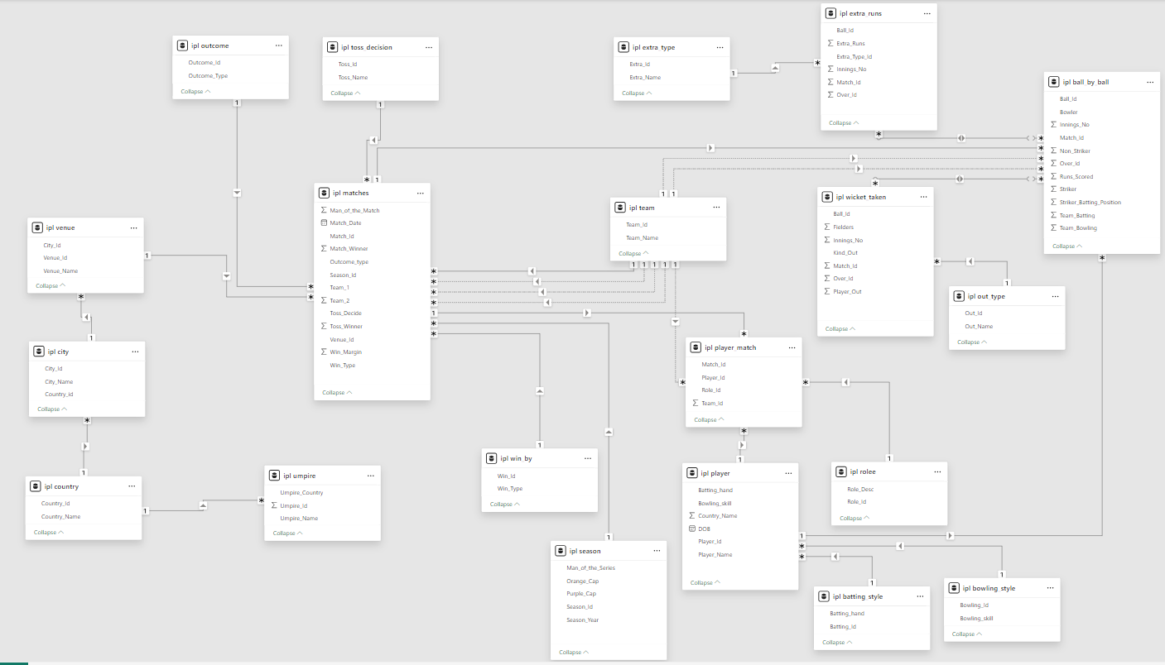
Database schema

Slide 4
METHODOLOGY
Data Collection & Cleaning.
Consolidated IPL ball-by-ball, match, player-auction price and injury data (2008-2016).
Performance KPI
Defined role-specific KPIs: Runs + SR + Consistency Index for batters; Wickets + Economy + Phase Impact for bowlers; combined indexes for all-rounders & keepers.
Normalized metrics season-wise to account for rule & venue changes.
Value-for-Money
Calculated “Cost per Impact Point” using historical auction fees and salary caps.

Slide 5

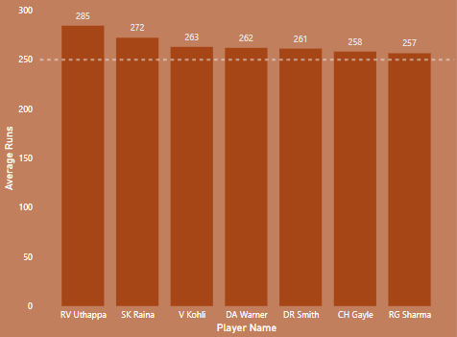
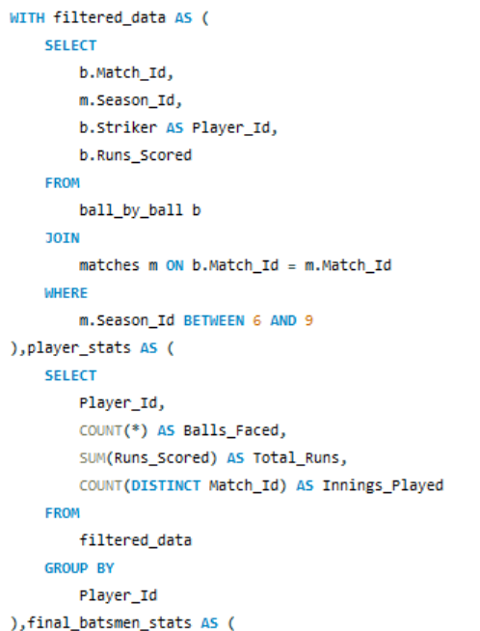
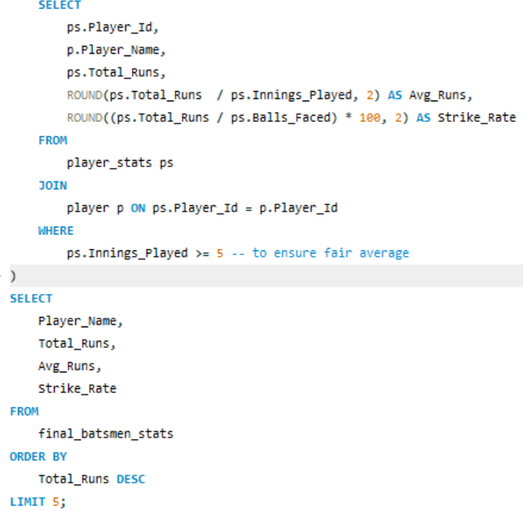
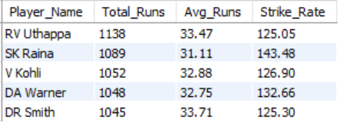
KEY INSINGHTS : Batting performance analysis
Virat Kohli was the orange cap holder in 2016 with unbeatable 973 runs.
In top 5 batsmen, 3 Indian and 2 overseas player.
Top scorer RV Uthappa with 1138 runs and 33.47 average.

Slide 6
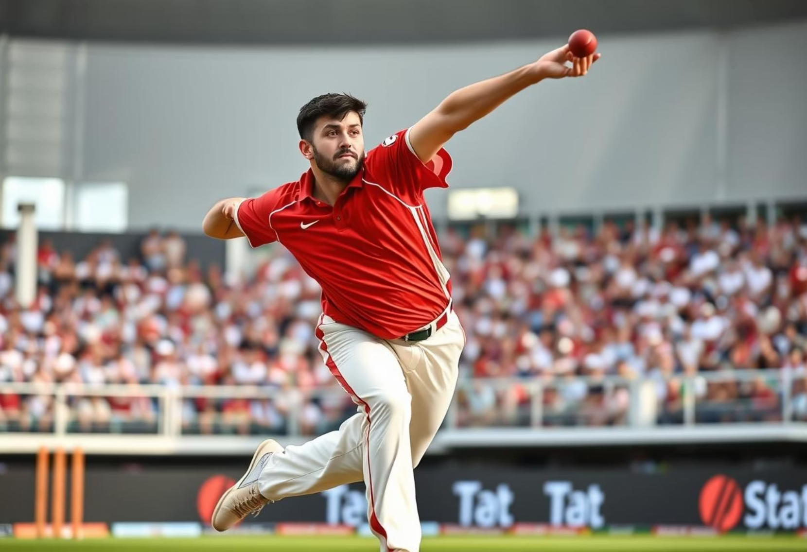
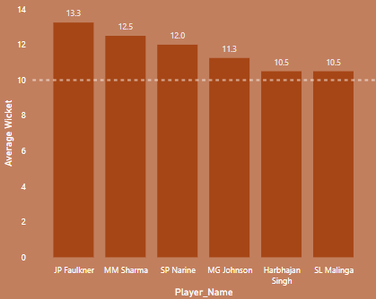
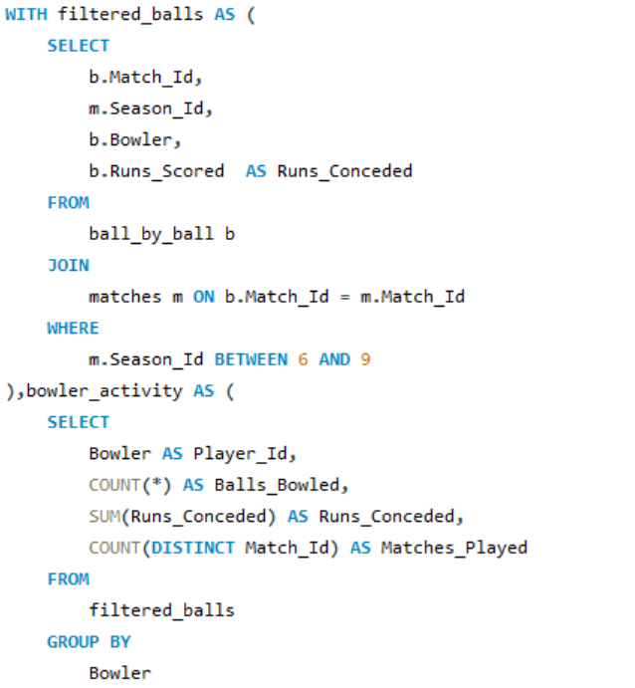
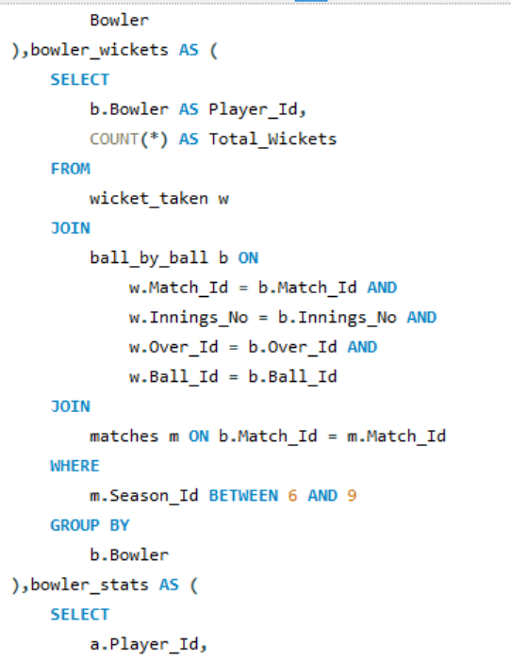
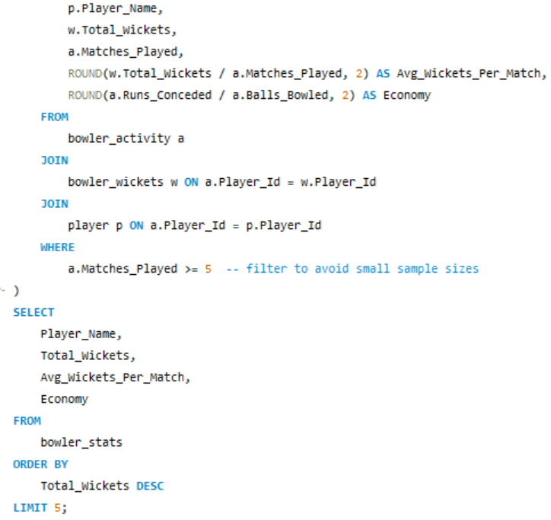
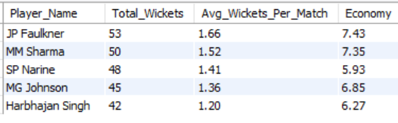
KEY INSINGHTS : Bowling performance analysis
JP Faulkner was the highest wicket taker till season 9 with 53 wickets and 7.43 economy.
Bhuvneshwar Kumar was the purple cap holder in 2016 with 23 wickets and 7.42 economy.
In top 5 bowlers, 3 overseas and 2 Indian player.

Slide 7
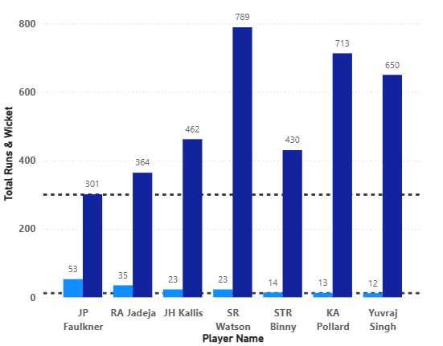
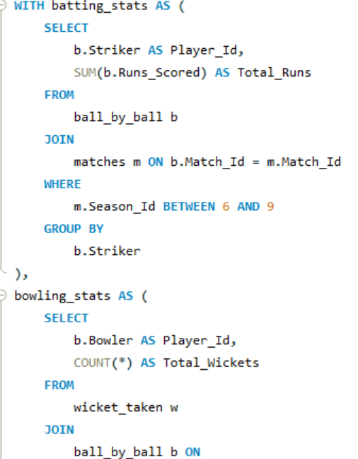
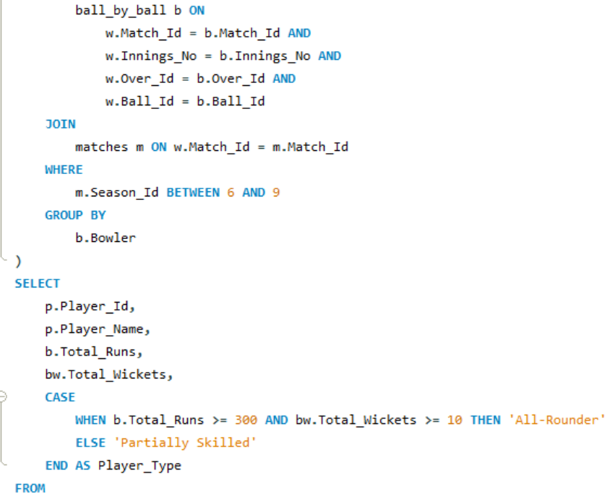
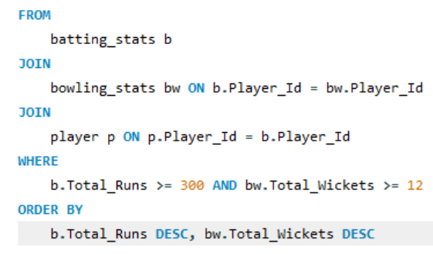
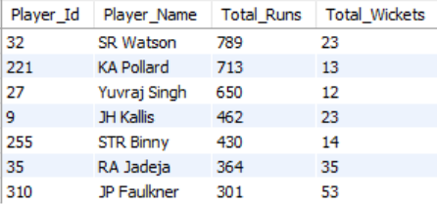
KEY INSINGHTS : All-rounder performance analysis
SR Watson was the top all-rounder with 23 wickets and 789 runs.
Indian top performer was Yuvraj Singh with 12 wickets and 650 runs.
All-rounders are pivotal to team balance.
We seek players who can consistently deliver in both departments and provide tactical flexibility, making them invaluable assets.

Slide 8
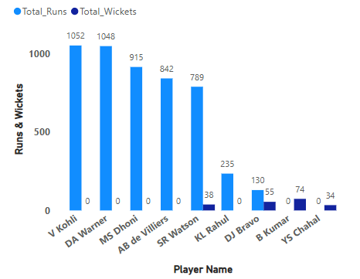
STRATEGY : Most valuable players
Prioritize Proven Match-Winners: Target top-order anchors like Kohli, Warner and Rahul.
Invest in explosive middle-order players like AB de Villiers, Dhoni and Russell, who can change the course of a match in the final overs.
All-rounders like Watson and Bravo offer dual value by contributing with both bat and ball.
Bhuvneshwar, Mustafizur, and Chahal are wicket-taking specialists — securing them will help control games and defend targets effectively.
While these players are premium, strategize bidding to avoid overpaying by setting maximum bid thresholds based on performance-impact analysis.

Slide 9
CONCLUSION
Prioritizing consistently, impact-driven players who align with both performance metrics and cost-efficiency. By targeting undervalued assets, strengthening bowling depth, and minimizing over-reliance on top-order stars, So RCB can build a balanced squad to pursue tournament success.

Slide 10


